Slide 1
Setting Up a Free Basic Receivables Account in Bill.com As An Individual
for vendors, contractors, grantees, non-employee recipients of stipends and reimbursements, and investors connected with
Center for Economic Democracy
Last Updated: January 2022

Slide 2
Bill.com is the vendor payment platform that the Center for Economic Democracy uses to make payments to our vendors, contractors, consultants, stipend recipients, grantees, and investors (including those of our fiscally-sponsored projects, the Boston Ujima Project and the Center for Cooperative Development & Solidarity)
When we need to make a payment to a company or individual that isn’t already a Bill.com user, we create a payment profile for them in our Bill.com account, and send them an invitation to connect with us and turn this profile into their own free basic Bill.com account, where they can choose to receive payment via direct deposit. (If they ignore the invitation, we send the payment via mailed paper check.)
The design of Bill.com for the end-user is currently targeted more towards businesses than towards individuals, but individuals can definitely use it also! Follow the instructions in these slides...

Slide 3
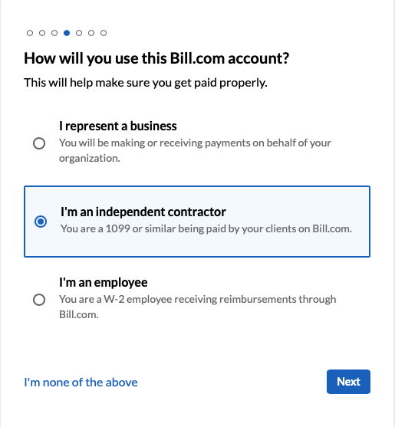
When you click the link in your invite to Bill.com, it will take you to a page like this. ➨ If you’re a vendor, contractor, consultant, or stipend or reimbursement recipient, choose the “independent contractor” category (even if you are being paid less than $600 and so won’t receive a 1099 from us). ➨ You can also choose this category if you’re an investor who will be receiving interest from us or a non-employee being reimbursed by us (choosing “none of the above” should take you to the same series of steps).

Slide 4
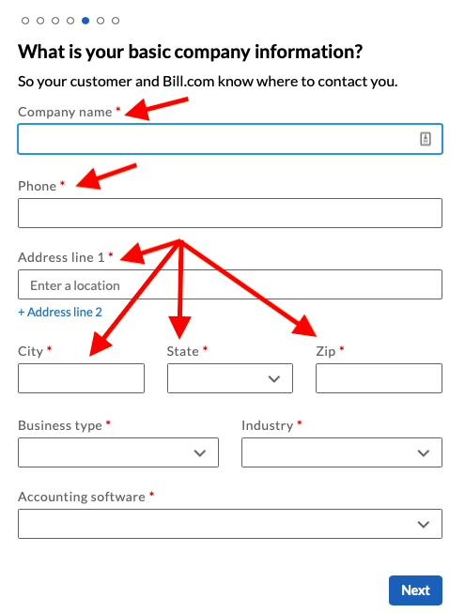
➨ List your own name in the “Company name” field (unless you use a business name as an alias) ➨ List your own phone number in the “phone” field ➨ List your own address in the address fields. Please note that the system does not accept P.O. box addresses, but you can use a 2nd line to enter an “in care of” (“c/ o”) address if needed. ➨ See next slides for instructions on the dropdown menus “Business type”, “Industry”, and “Accounting Software”

Slide 5
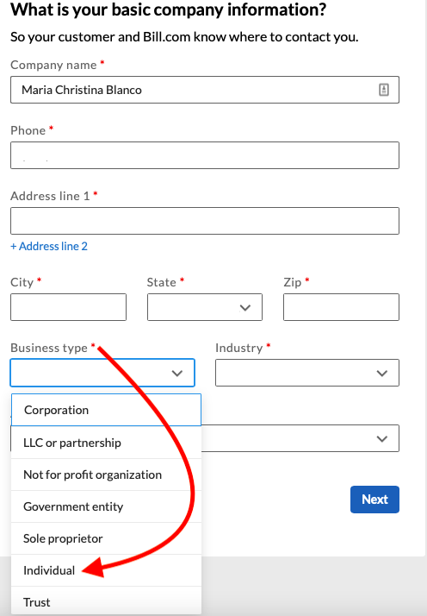
In the “Business type” field, choose “Individual”

Slide 6
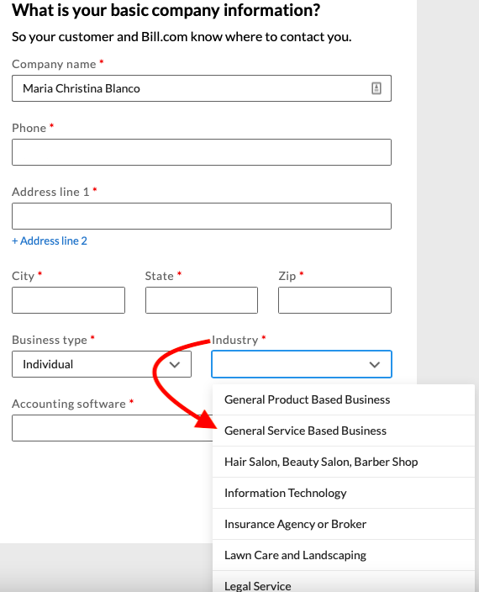
Currently, there isn’t a completely accurate option for the “Industry” field, so we recommend choosing “General Service-Based Business” (unless new options like “other” or “none of the above” are added).

Slide 7
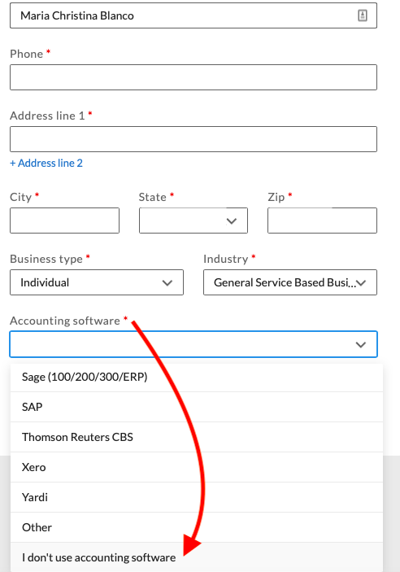
In the “Accounting software” field, choose “I don’t use accounting software”, unless you do use one of the listed programs to track your personal finances

Slide 8
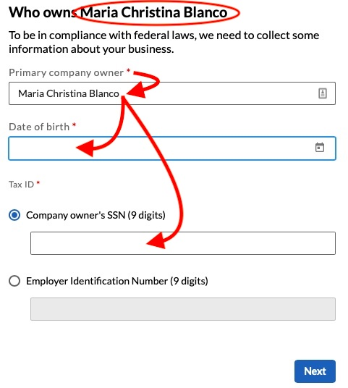
In the 1st step, you entered your own name as your company name. At this step, where the system asks you about who owns your company: ➨ In the “Primary company owner” field, again list your own name ➨ In the “Date of birth” field, list your own D.O.B ➨ In the “Company owner’s SSN” field, list your own name Social Security Number

Slide 9
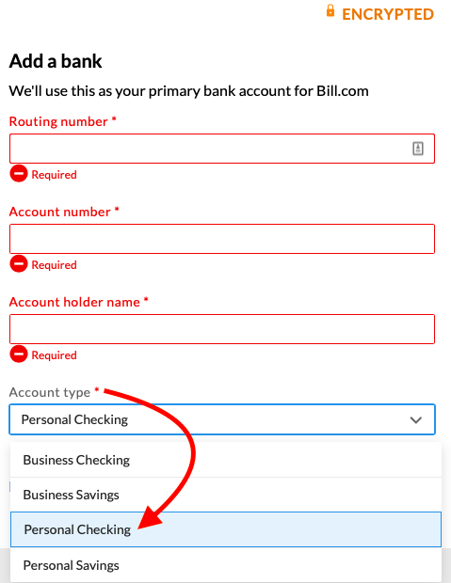
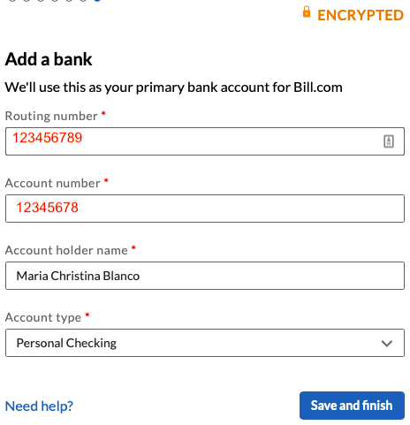
Fill out the “Add a bank” fields and in the “Account type” dropdown menu, choose “Personal Checking” or “Personal Savings”
←←←
Blank
→→→
Completed

Slide 10
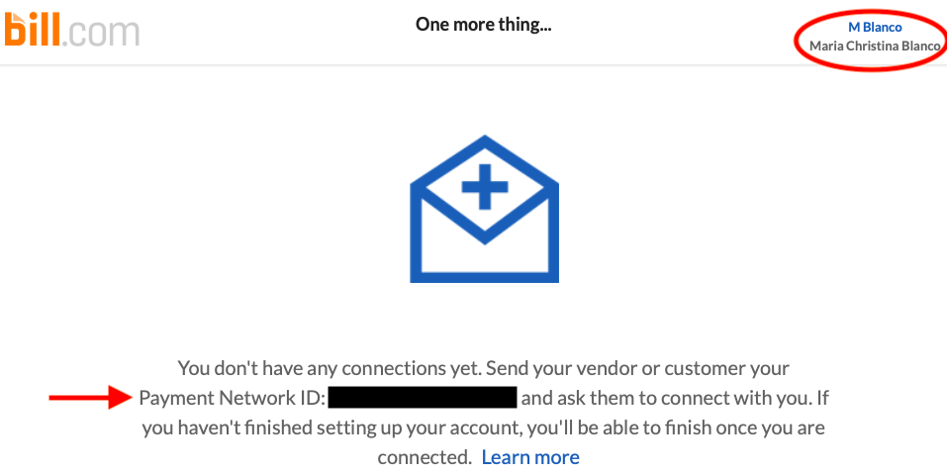
Now you’ve set up your account and been assigned a Bill.com Payment Network ID! Make sure to accept CED’s connection request so we can pay you. Thanks!

